Slide 1


Team Members:
SAVINAY PANDEY - 21102125
PRANAV PATIL - 21102180
GAUTAM PANDEY - 21102117
PRATIK PATIL - 21102099
TITLE : OMR SYSTEM (Quick Grade)

Slide 2
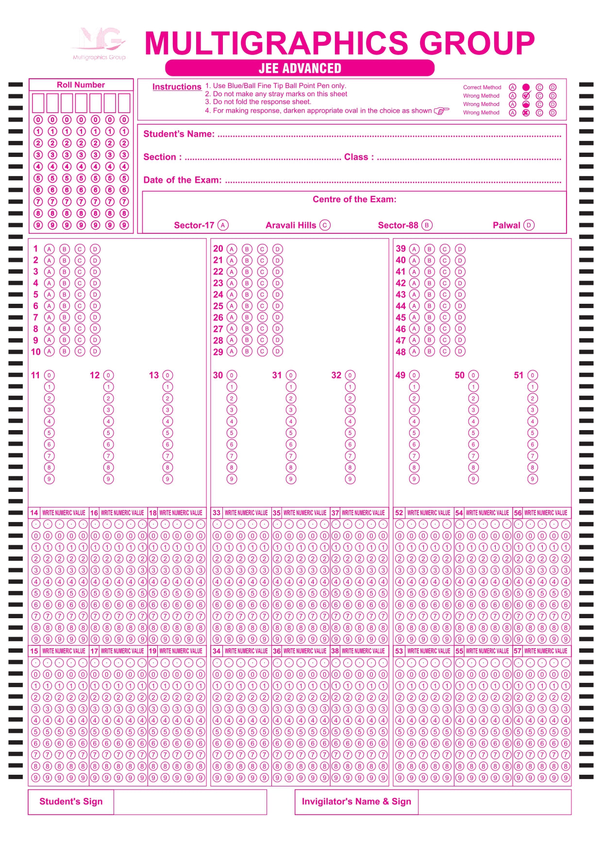
Problem Statement
In educational institutions and assessment centers, manual grading of multiple-choice exams is a time-consuming and error-prone process.
The project aims to design and develop a robust and efficient OMR system that can accurately scan, interpret, and grade multiple-choice answer sheets.

Slide 3


Objectives
Create algorithm to accurately detect and interpret marked areas on the answer sheets. The system should be able to distinguish between valid marks, crossed-out marks, and other artifacts to ensure precise data extraction.
Major objective is to provide a scan accuracy of 100% in realtime.
Implement a grading mechanism that assigns scores based on the correct and incorrect answers, following predefined grading rules.
Create algo such that it can mark and recognize sheets in realtime , that is no need to upload answer sheet just put it in front of stable web cam.

Slide 4
Architecture Diagram:

Slide 5
Technology Stack
• Software Requirements: -
1.Python(cv2,MySQL connector,numpy,pyautogui,os)
2.Flask libraries(session,render_template,response,redirect,jasonify)
3.Mysql server and database “omr_logs”
4.Web browser
5.Working Webcam
6.Operating system
7.Text editor (Vscode or Pycharm)
• Hardware Requirements: -
1) CPU: core i5
2) RAM: 8.00 GB (7.68 GB usable)
3) STORAGE: 512 GB
4) PROCESSOR: 12th Gen Intel(R) Core (TM) i5-1235U 1.30 GHz
5) OS: Windows
6) INTERNET CONNECTIVITY: Medium

Slide 6
Implementation:
The project is divided particularly in 3 modules
a) OMR-Sheet Scan
b) Binary image processing and detect contours
c) Grading the OMR detection
d) Capture Virtual OMR sheet with grading(Screenshot)

Slide 7
a) OMR - Sheet Scan:-
So in this module it will capture the live video and generate frames.
Code Snippet :-
.then(function(data) {
//Check the response from Flask
if (data.login_successful) {
// Login was successful, execute your JS function or redirect to another page
alert('Login successful! Now Please Insert your Inputs');
if (mainElement.style.display === "block" || mainElement.style.display === "") {
// Hide .main and show .next
mainElement.style.display = "none";
nextElement.style.display = "block";
} else {
// Show .main and hide .next
mainElement.style.display = "block";
nextElement.style.display = "none";
}
} else {
//Login failed, show an error message or take appropriate action
alert('Login failed. Please check your credentials.');
}
})
.catch(function(error) {
console.error('Error:', error);
});

Slide 8
b) Binary image processing and detect contours :-
In this module Preprocessing of the captured frame is done. It identifies the biggest contour and stack the images , get the Bird-eye view of the biggest contour.
Code Snippet :-
def stackImages(imgArray,scale,lables=[]):
rows = len(imgArray)
cols = len(imgArray[0])
rowsAvailable = isinstance(imgArray[0],list)
width = imgArray[0][0].shape[1]
height = imgArray[0][0].shape[0]
if rowsAvailable:
for x in range (0, rows):
for y in range (0, cols):
imgArray[x][y] = cv2.resize(imgArray[x][y], (0,0), None , scale , scale)
if len(imgArray[x][y].shape) ==2: imgArray[x][y] =cv2.cvtColor (imgArray[x][y], cv2.COLOR_GRAY2BGR)
imageBlank = np.zeros((height , width, 3), np.uint8)
hor = [imageBlank]*rows
hor_con = [imageBlank]*rows
for x in range(0, rows):
hor[x] = np.hstack(imgArray[x])
hor_con[x]= np.concatenate(imgArray[x])
ver = np.vstack(hor)
ver_con = np.concatenate(hor)

Slide 9
c) Grading the OMR detection :-
Here it detects the second biggest contour for grade box and according to the marks on the OMR it calculates and prints the percentage on the grade box.
Code Snippet :-
# GRADING
grading = []
for x in range(0, questions):
if ans[x] == myIndex[x]:
grading.append(1)
else:
grading.append(0)
# print(grading)
score = (sum(grading) / questions) * 100 # FINAL GRADE
print(score)

Slide 10
d) Capture Virtual OMR sheet with grading(Screenshot):-
User is able to download the screenshot of the webcam feed output along with the virtual marking and the grading with accuracy.
Code Snippet :-
captureButton.addEventListener('click', () => {
// Get the user-entered file name
const customFileName = filenameInput.value || 'webcam_screenshot';
// Get the video container's dimensions
const containerWidth = document.getElementById('video-container').offsetWidth;
const containerHeight = document.getElementById('video-container').offsetHeight;
// Create a canvas with the same dimensions as the video container
const canvas = document.createElement('canvas');
canvas.width = containerWidth;
canvas.height = containerHeight;
const context = canvas.getContext('2d');
// Draw the video frame onto the canvas, cropping it to fit the container
context.drawImage(video, 0, 0, containerWidth, containerHeight);
// Convert the canvas to a data URL
const dataURL = canvas.toDataURL('image/png');
// Create a download link with the custom file name
const a = document.createElement('a');
a.href = dataURL;
a.download = `${customFileName}.png`;

Slide 11
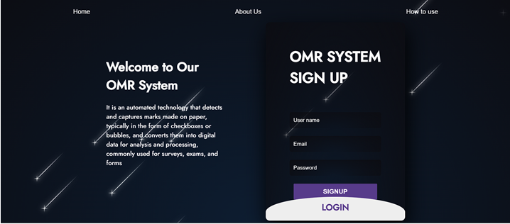
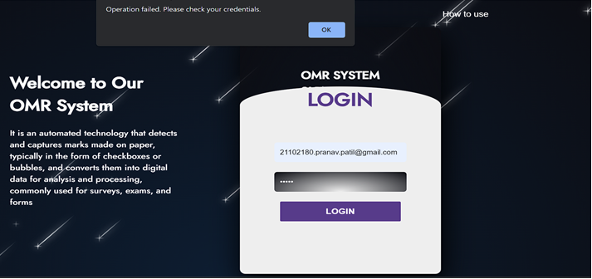
Result:

Slide 12
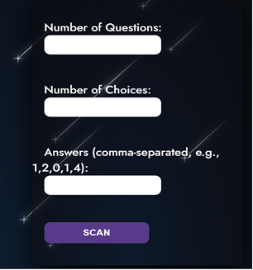
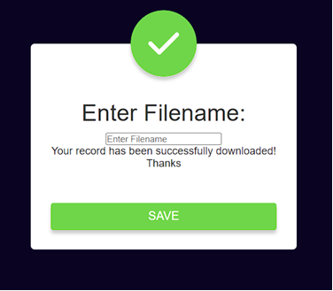

Slide 13
[1] Daniel O'Connell (2011) O'Connell has conducted research on improving the accuracy of OMR systems, particularly in the context of educational testing. Look for papers related to OMR accuracy enhancement.
[2] Jahan M. Dawlaty (2012). Dawlaty has contributed to research on using OMR technology in various fields, including healthcare and survey data collection. Search for his research on OMR applications.
[3] Eric Saund (2015). Eric Saund has been involved in the development of OMR software and technology. Explore his work on OMR software systems and their features.
[4] Richard J. Low (2019) Low's research has covered OMR security and privacy considerations. You can find his work related to OMR system security.
[5] R. C. Tenny(2022) R. C. Tenny has published research on the challenges and future trends in OMR technology. Look for his contributions in this area
Reference:

